Slide 1

Presented by : Amisha Gurndwal (2021a1r062) Sania Fotedar (2021a1r082) Amjid Khan (2021a1r106)

Slide 2
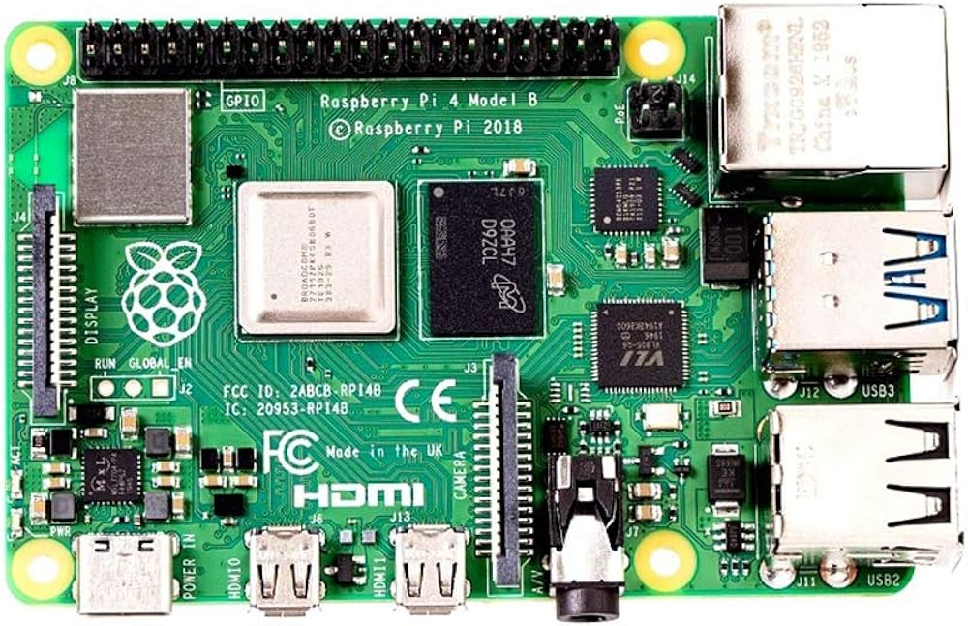
NAS(Network attached storage)
Hardware Components
Raspberry Pi 4
Storage Device (SSD,HDD or Pendrive)
Power Supply
Cooling System
SD card

Slide 3
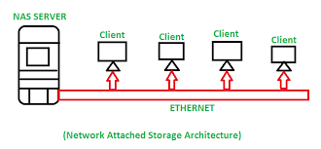
NAS(Network attached storage)
A NAS system is a storage device connected to a network that allows storage and retrieval of data from a centralized location for authorized network users.

Slide 4
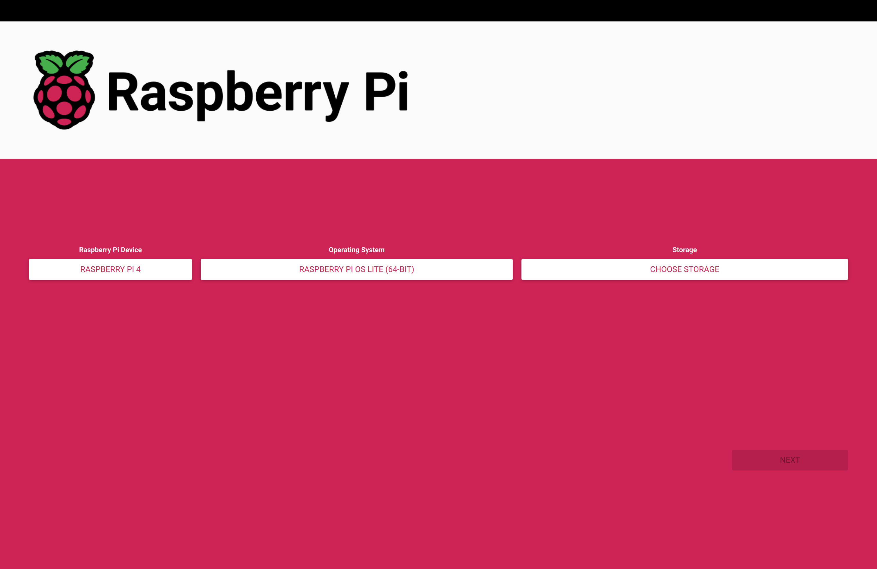
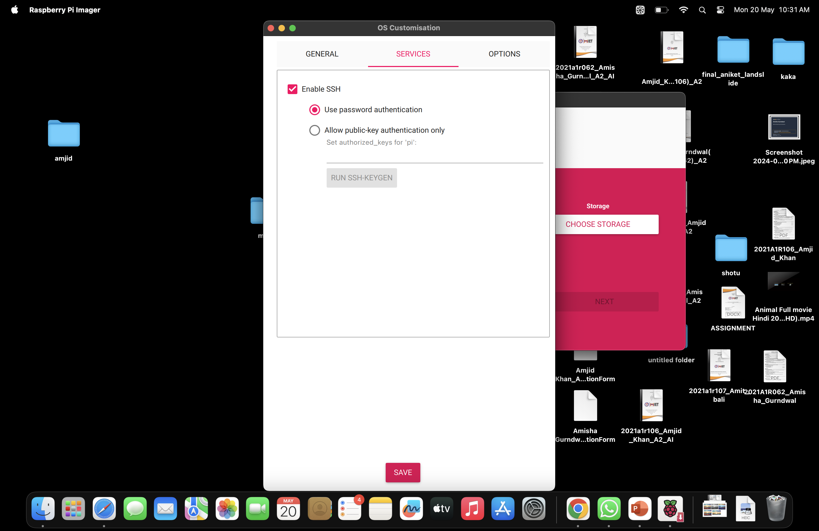
Creating a NAS
Installing Operating system in the SD card using Raspberry pi Imager(Raspberry Pi OS).
Also enabling SSH and setting up the username and password.

Slide 5
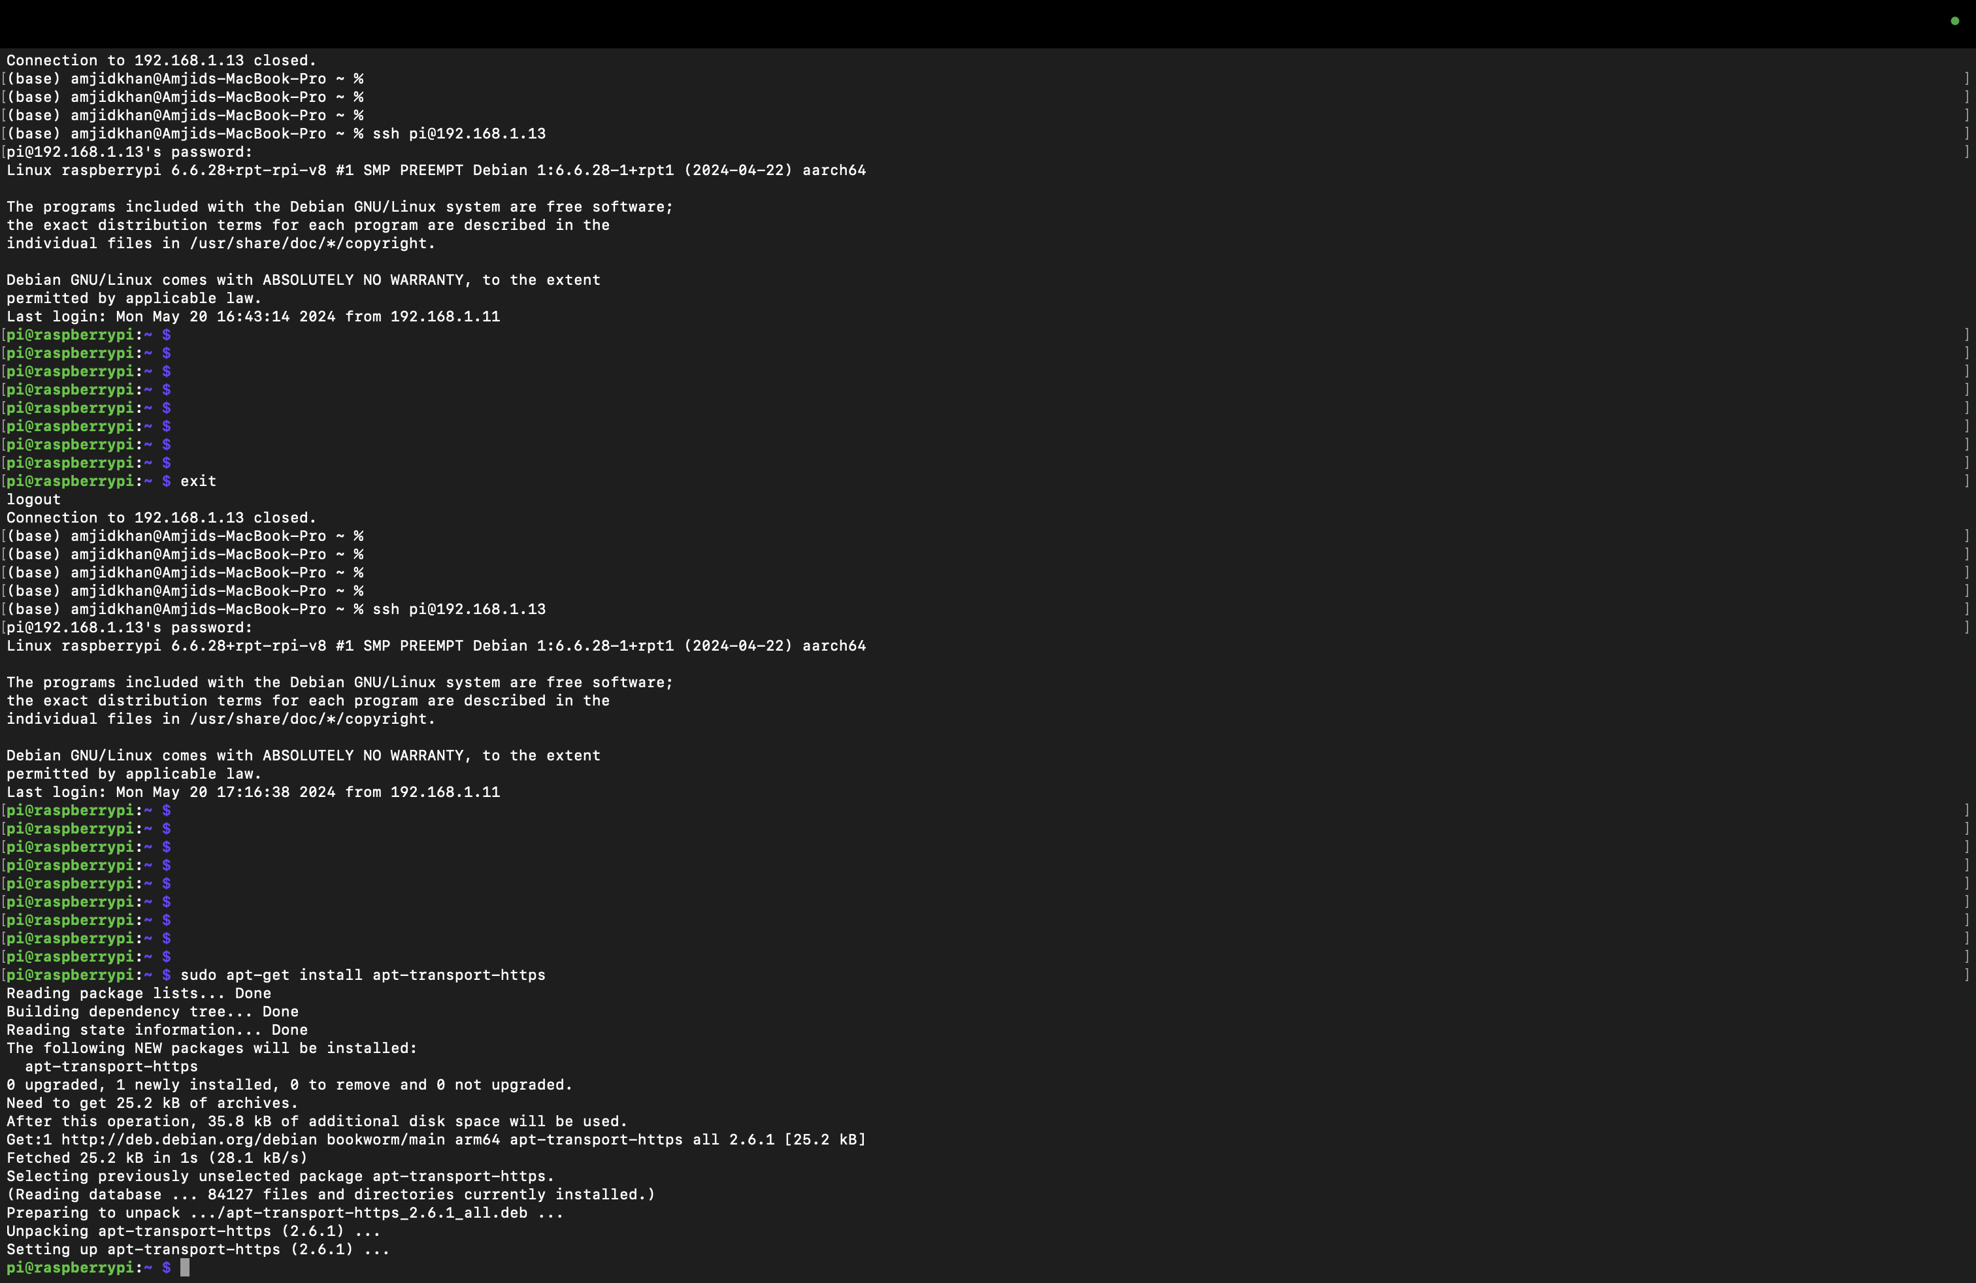
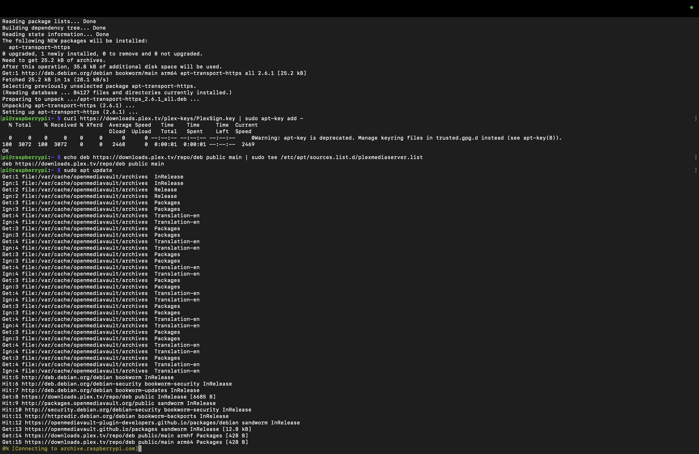
Updating the Pi
Accessing the Raspberry Pi using SSH through terminal.
After accessing the Raspberry Pi, update the Raspberry Pi.

Slide 6
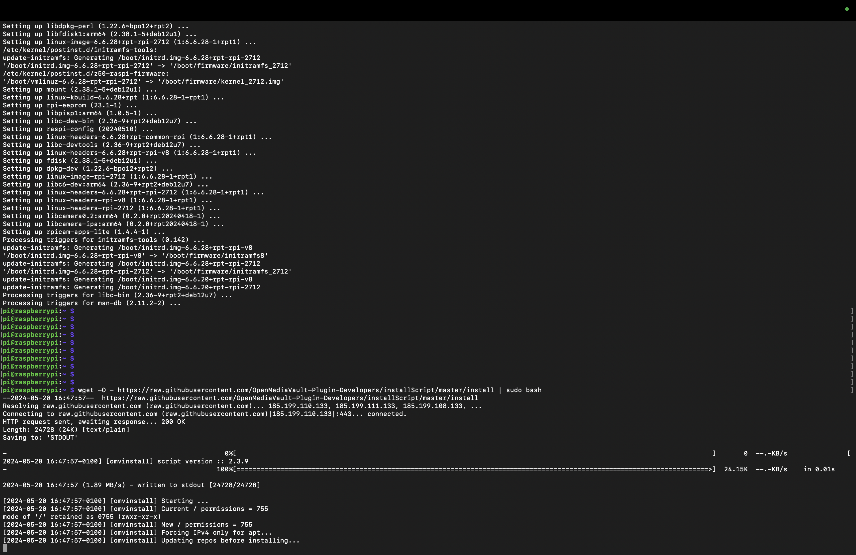
Installing NAS Software(Open Media Vault)
Downloading NAS Software from Github and installing it in the Raspberry Pi

Slide 7
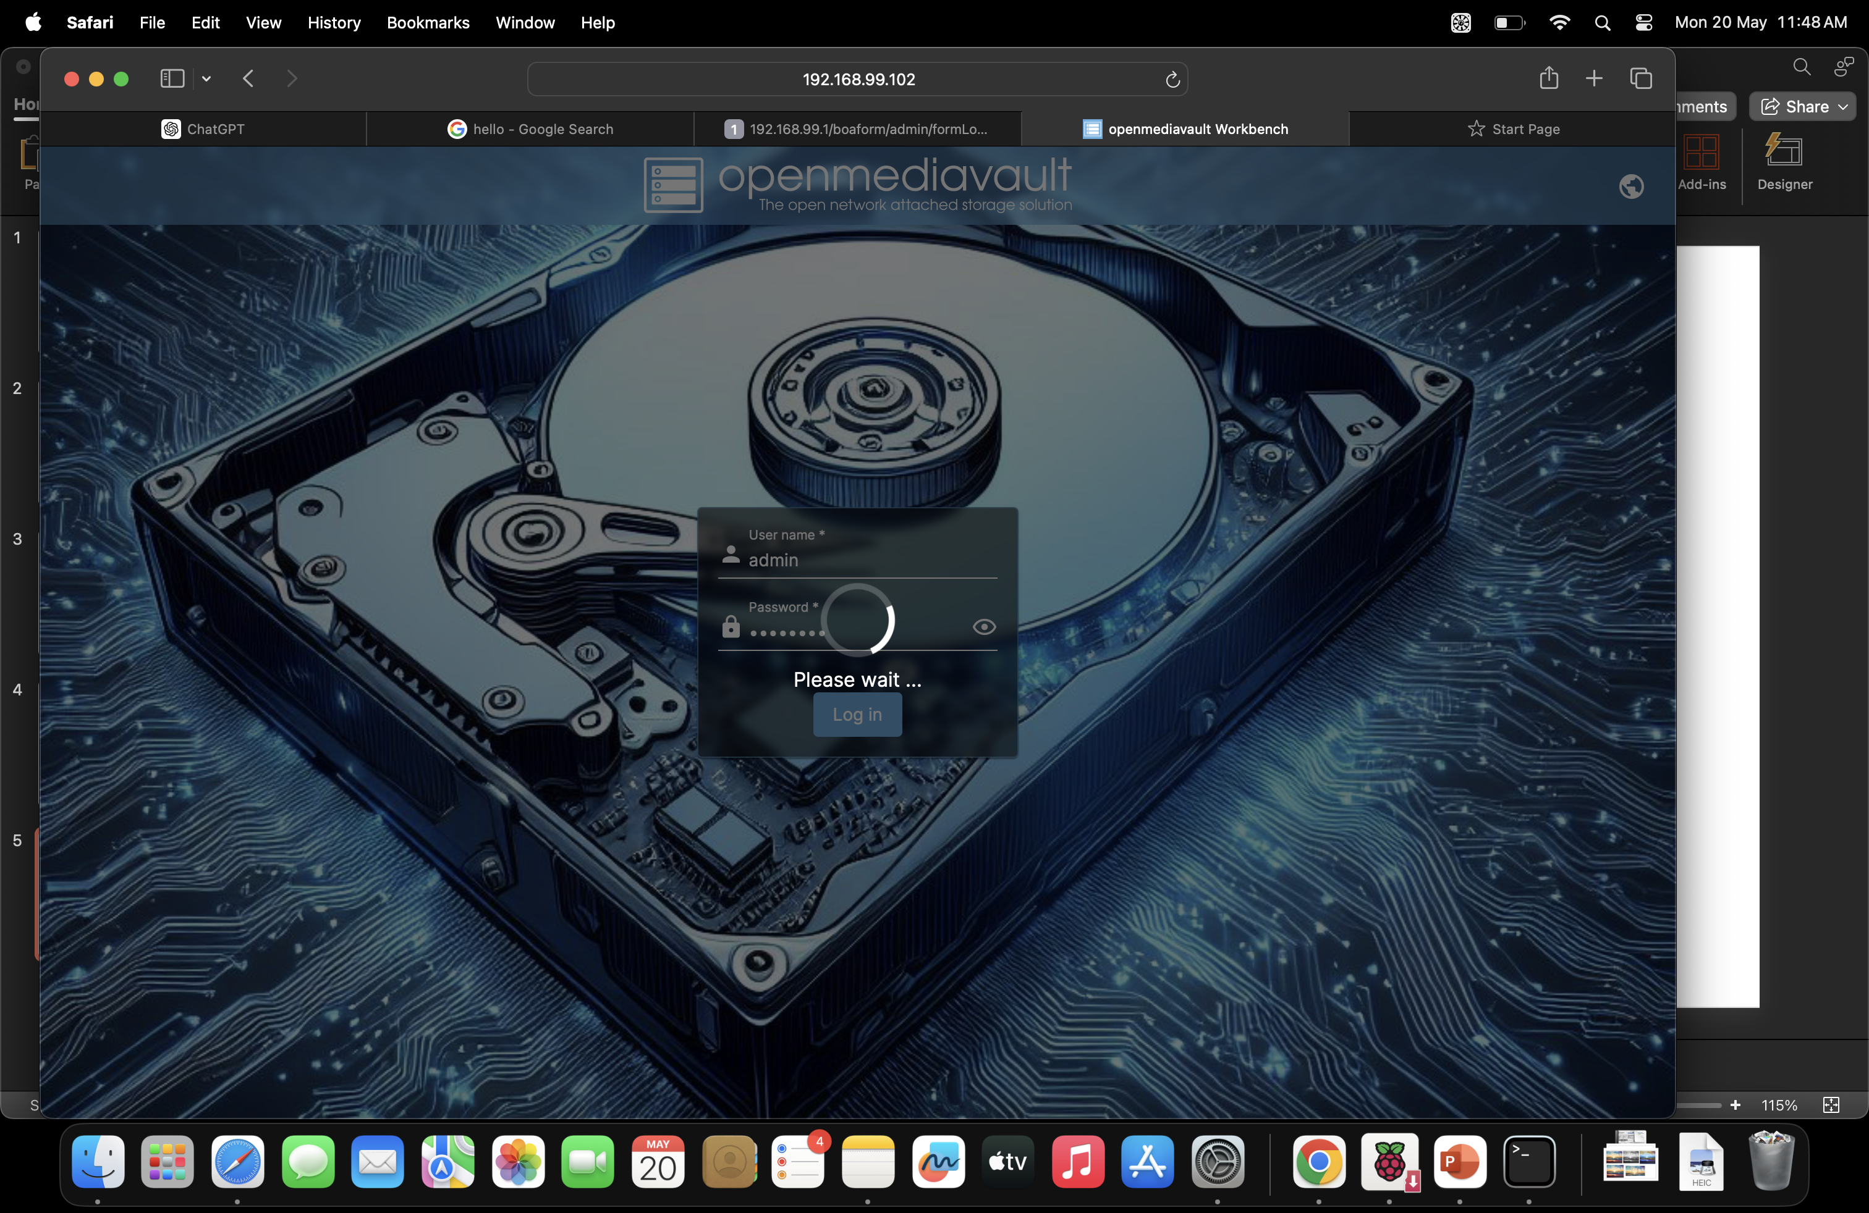
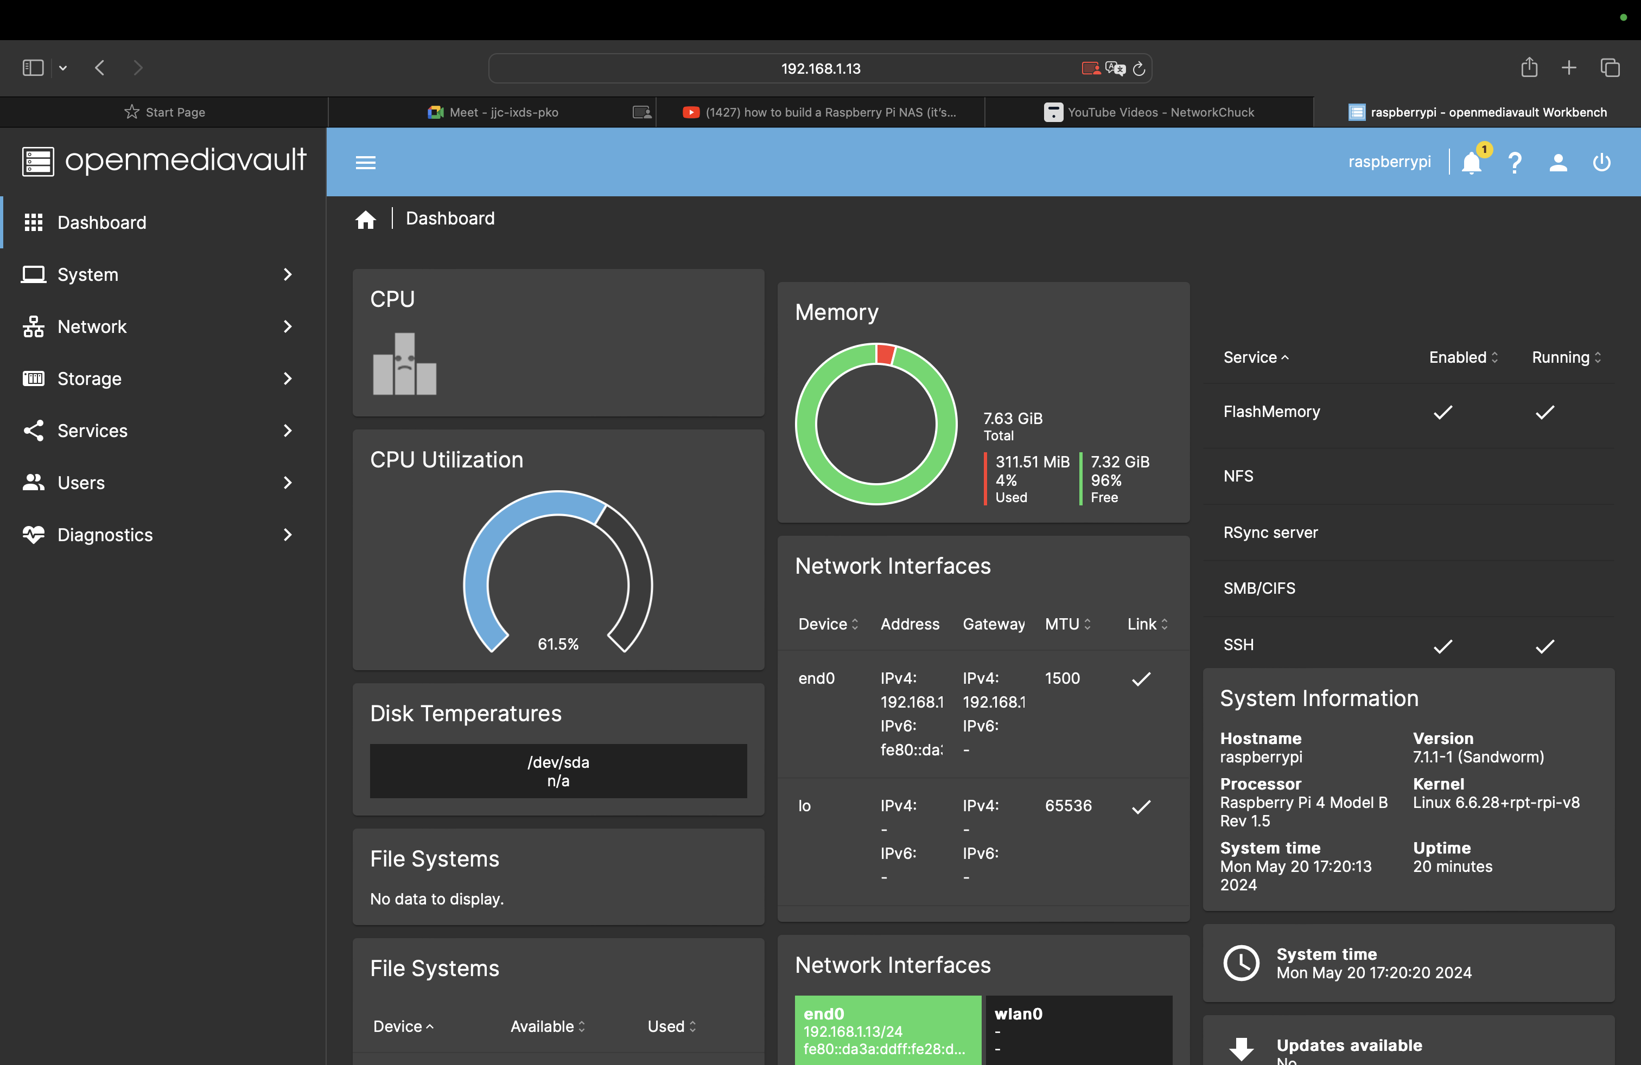
Open Media vault Interface
Access the Raspberry Pi NAS through any browser using its IP address.
Updating the default Password.
Adding the required monitoring widget for the Pi(NAS).

Slide 8
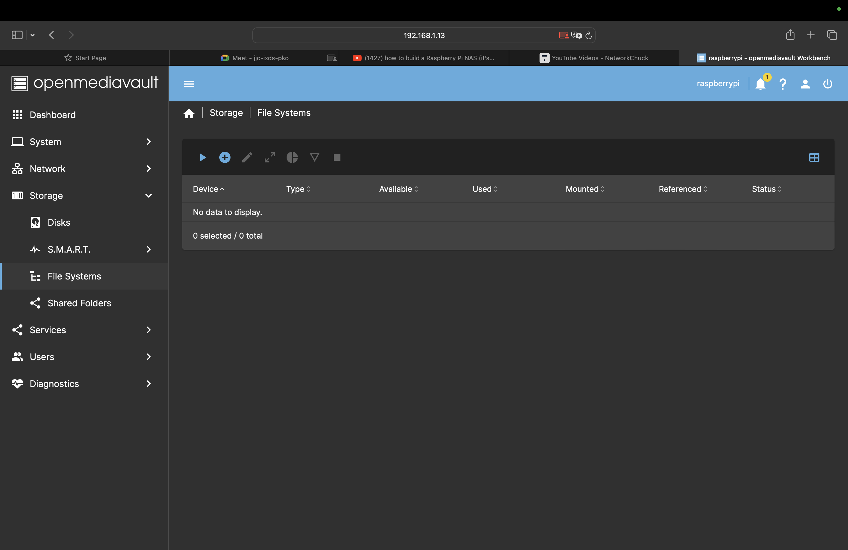
Creating a Storage Location
First mount the Storage device in the storage section.
Creating the share folder and naming it as mynas

Slide 9
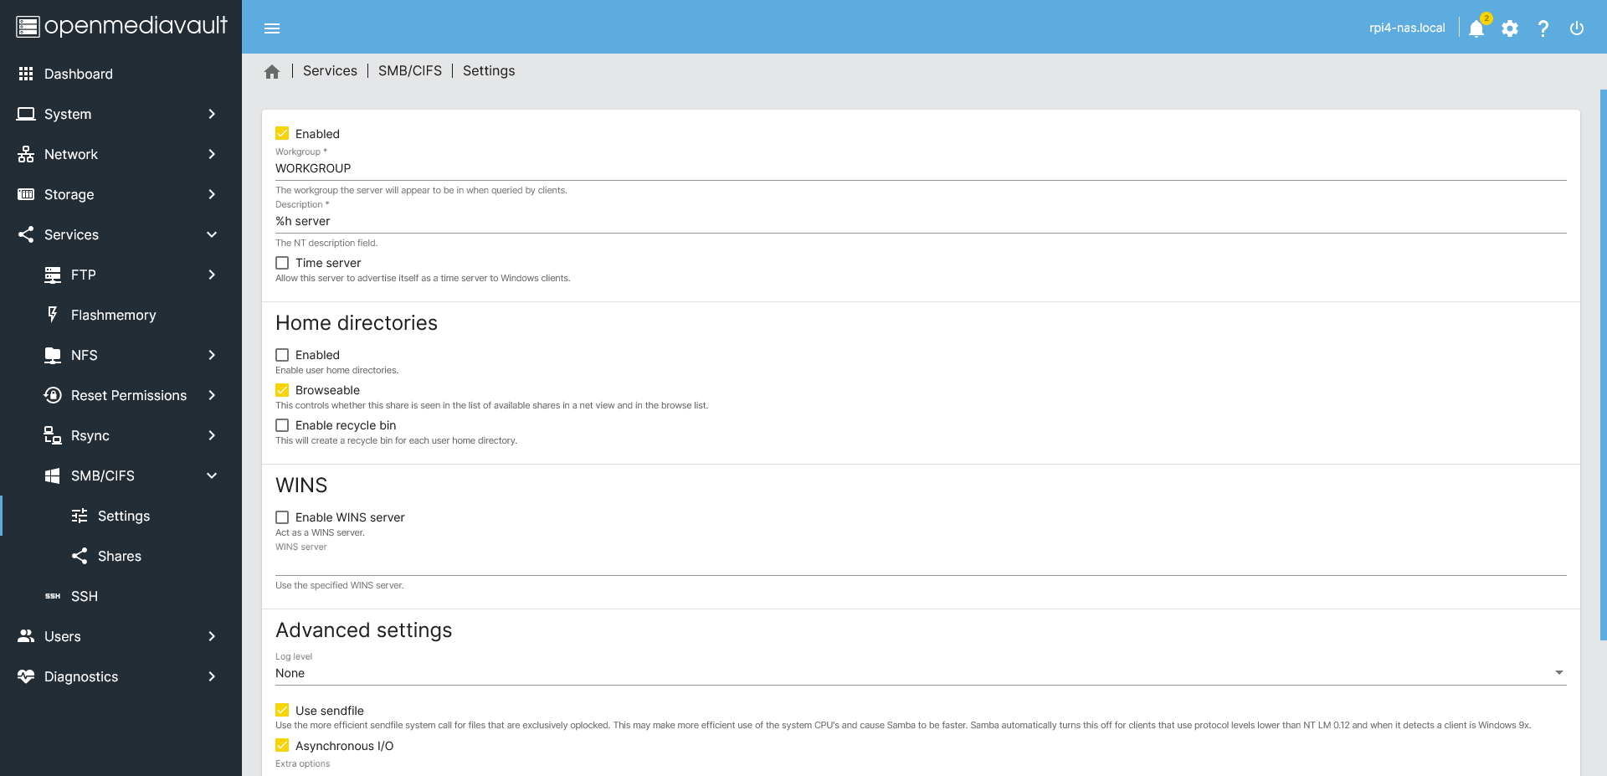
Accessing the NAS
Enabling the SMB services from the services section, as windows use SMB.
Similarly, the enabling NFS services, as Mac and Linux uses NFS.

Slide 10
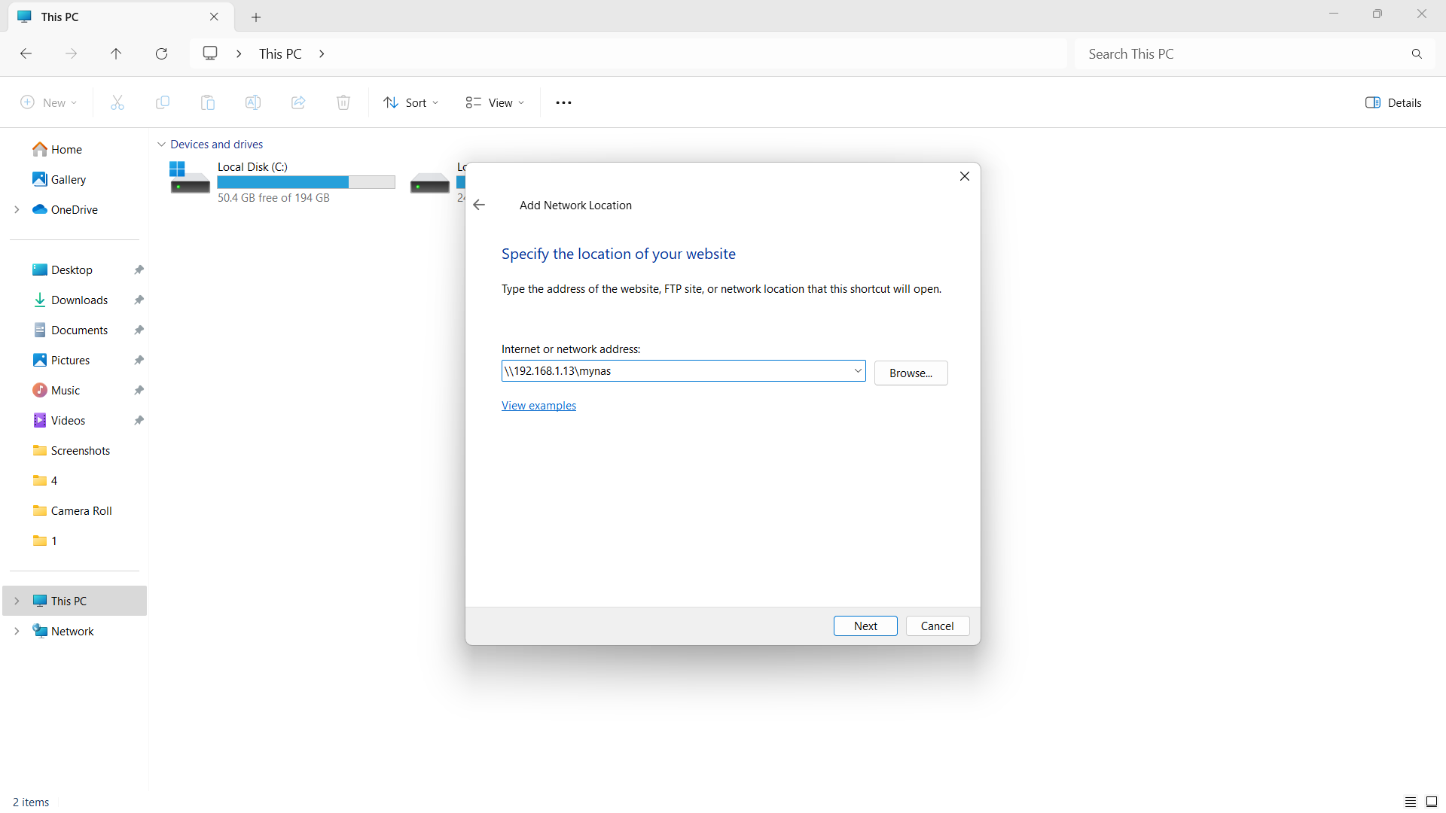
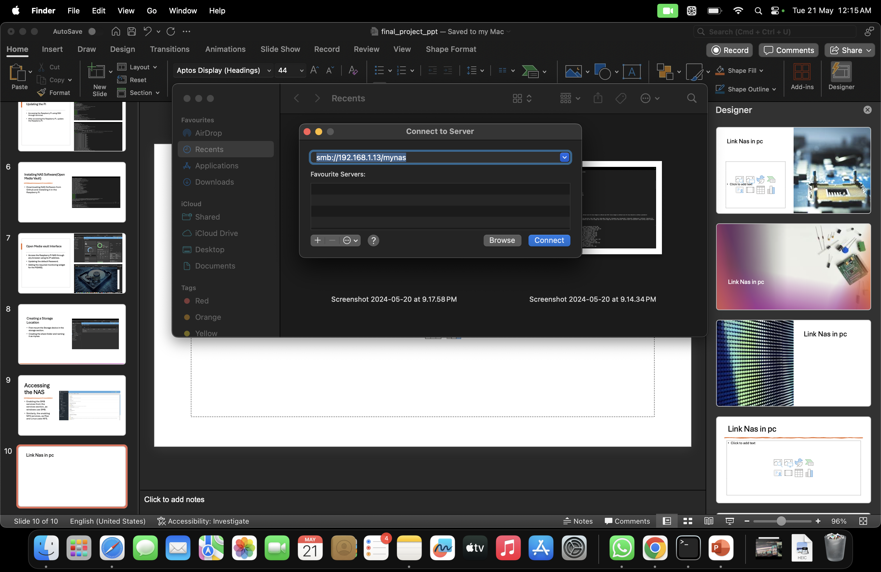
Connecting the NAS
We can add network locating in the file manager of Windows.
Also, we can add server location in the finder application of MAC.

Slide 11
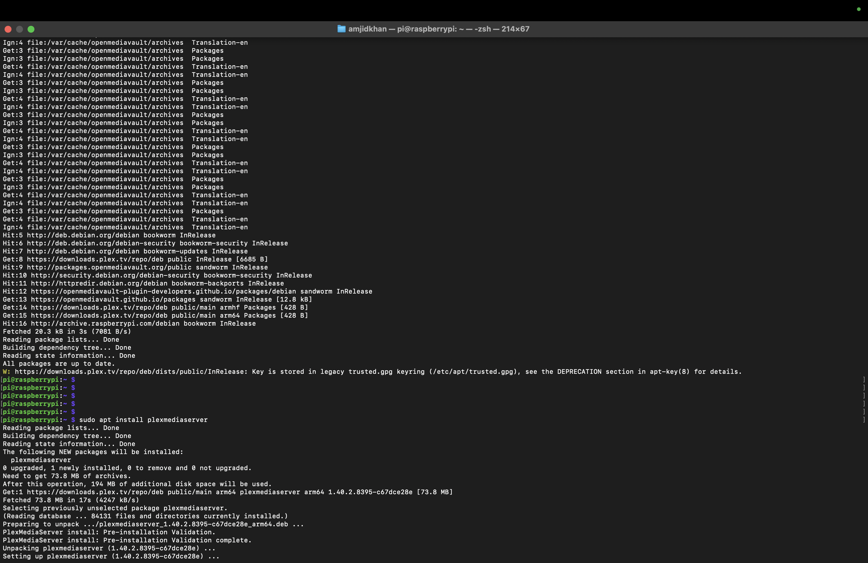
Installing Plex Media Server
We can install Plex Media Server in our NAS and we can access it from any network through UPNP(universal plug and play).

Slide 12
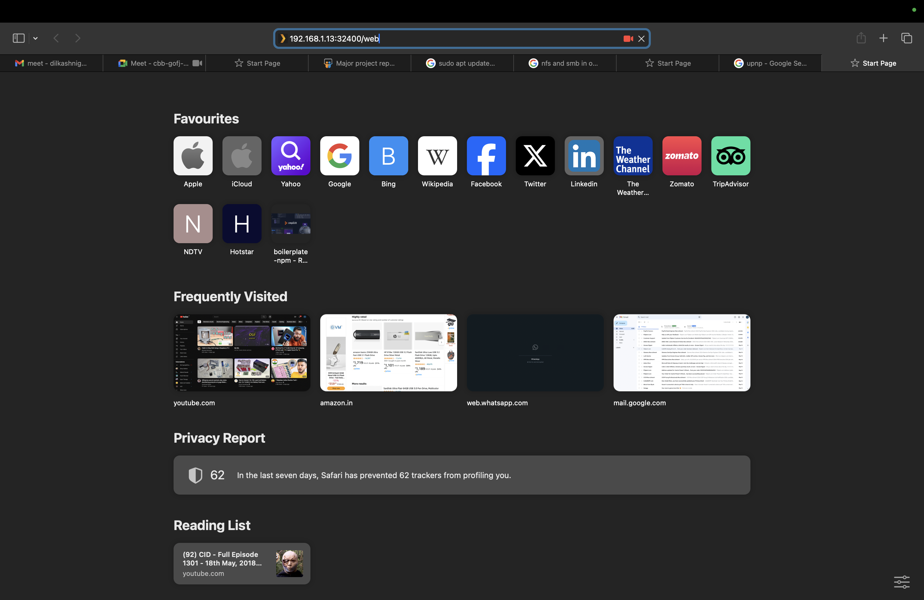
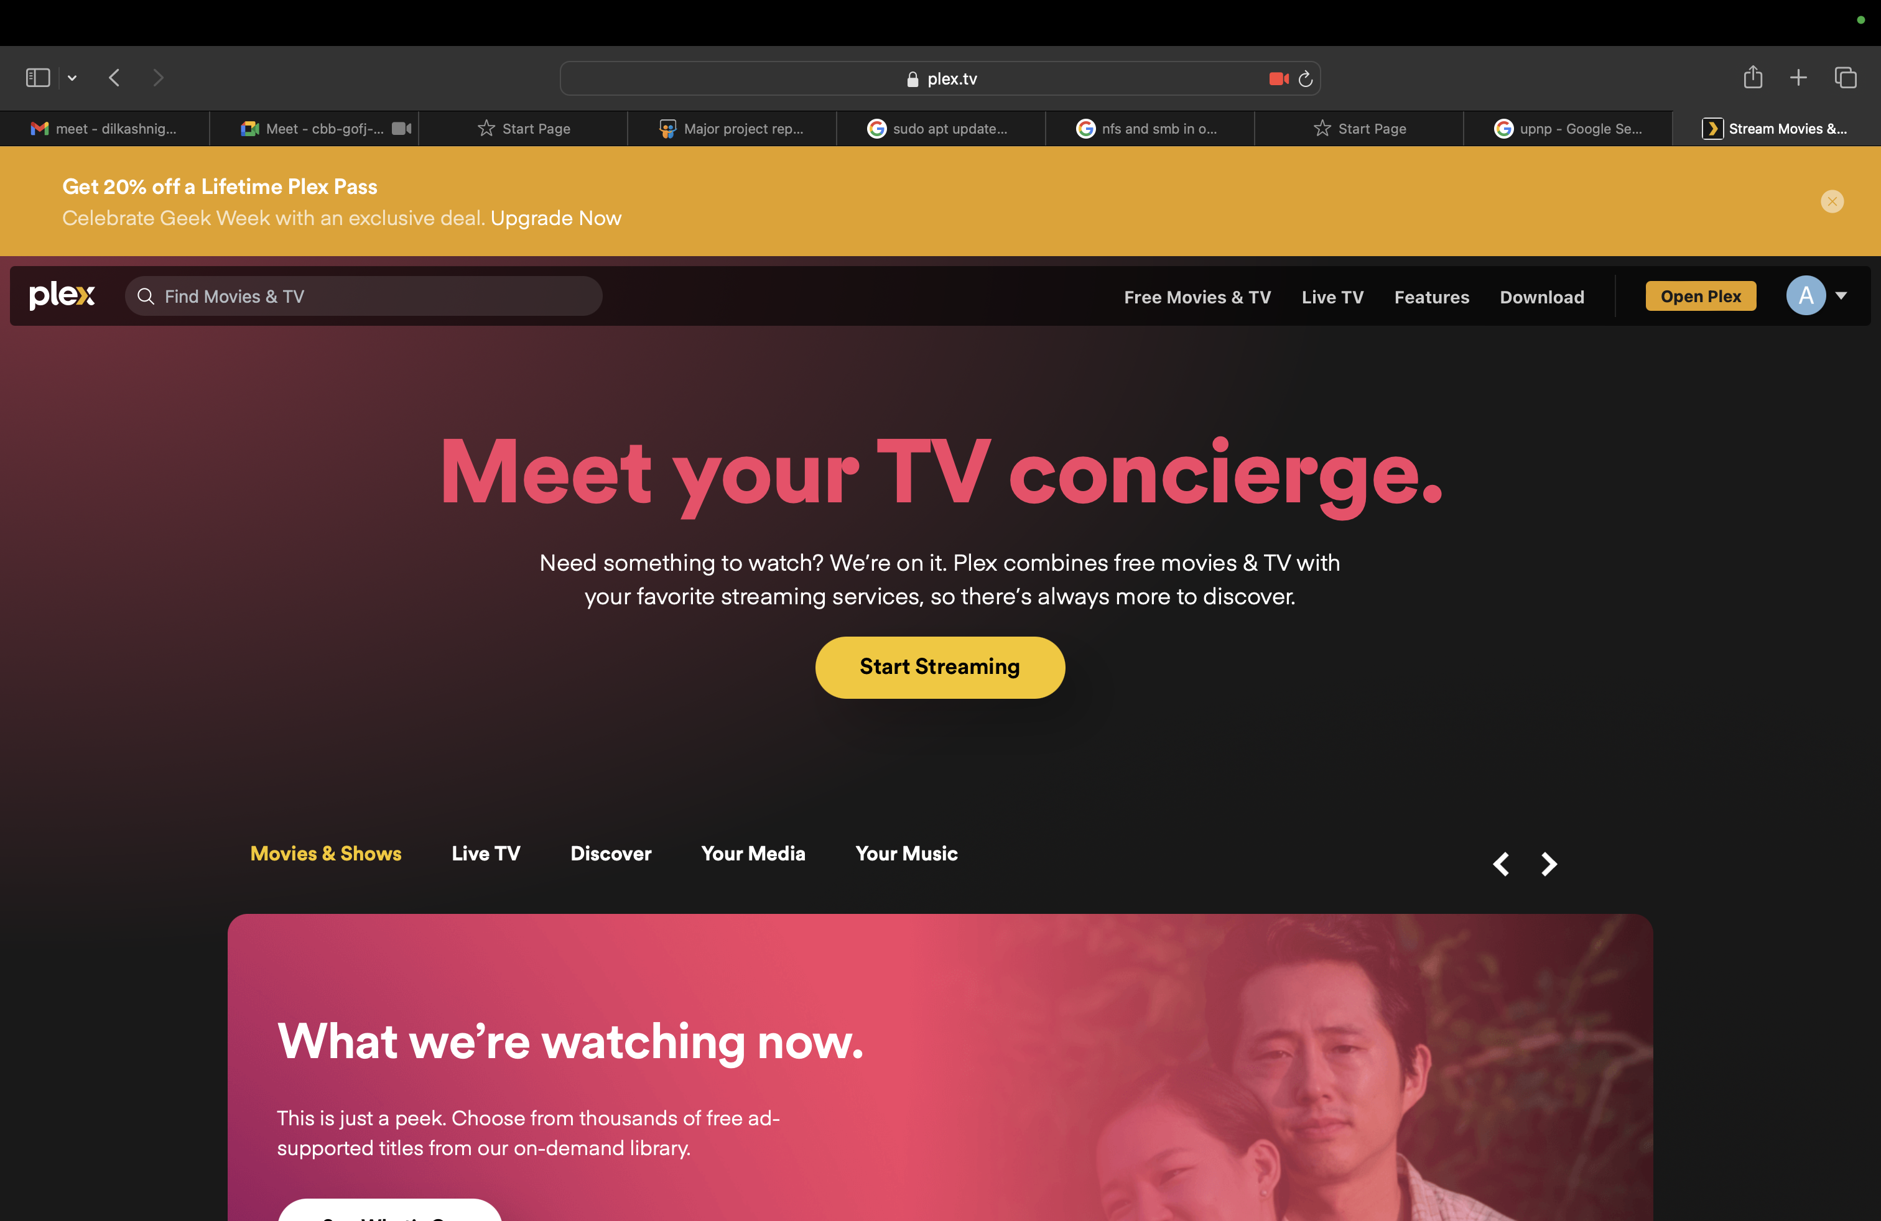
Plex Media Server
We can access Plex from the same network where NAS is connected using its IP address followed by the port no. of plex(192.168.1.13:32400/web)
We can also access it from different networks by installing the Plex application from the App Store or Play Store, or from the web page.

Slide 13


